Slide 1
Session 7 – High Dimensional Fixed Effects Data Skills for Research Kellogg Research Support
August 17, 2023

Slide 2

Fixed Effects
Fixed effects / group-specific intercepts are frequently used in econometric models:
Get rid of omitted variable bias
Handle potential unobserved heterogeneity
Increase precision

Slide 3

Roadmap
Why use Fixed Effects?
How to deal with “too many” fixed effects
de -meaning variables
Data Examples and Computational Horse Races
Stata
R
Python
Parallelizing Fixed Effect Code on KLC

Slide 4
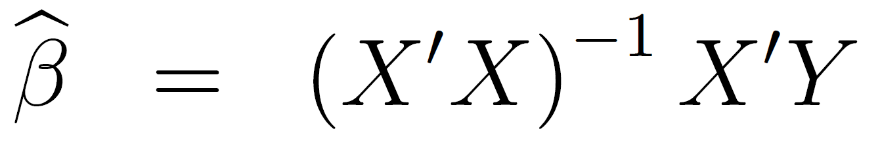
But that’s what we have computers for, isn’t it?
An important equation:
X’X is a k by k matrix, where k is the number of regressors
What does this mean if you have tens of thousands of fixed effects??

Slide 5
Frisch, Waugh and Lovell to the rescue
It turns out that including a full set of fixed effects to your predictor variables is equivalent to subtracting the group mean from each observation for each dependent and (‘other’) predictor variable, and running a regression using the demeaned variables
Many of the efficient fixed-effects algorithms use this trick

Slide 6
Which command/software is right for you?
Is the researcher interested in the point estimates/standard errors of the fixed effects themselves?
Are multiple levels of fixed effects used?
Do you need clustered standard errors? Clustered at what level?

Slide 7
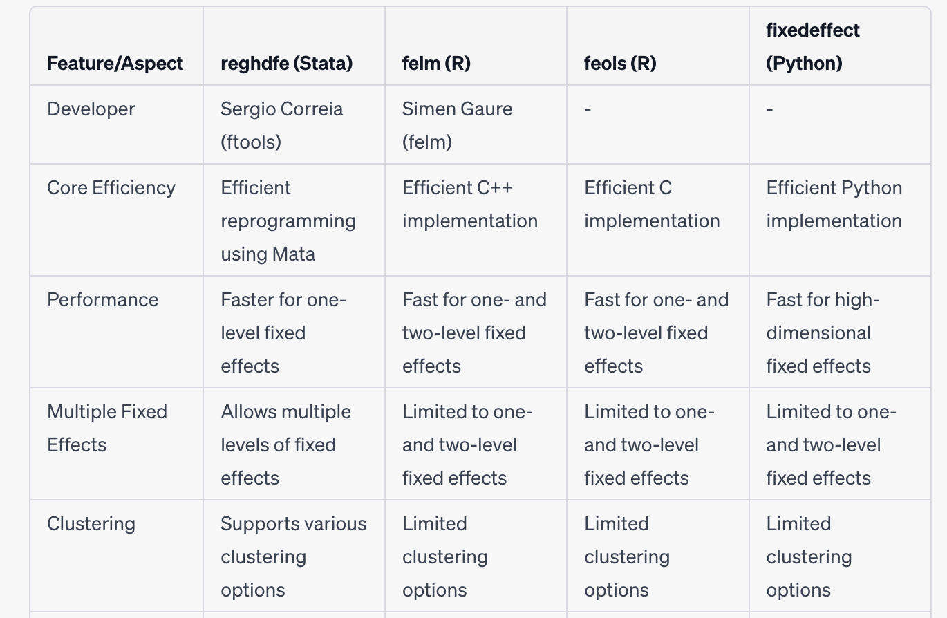
Package Comparison

Slide 8
Data Example
Dataset on Madison, WI home sales (Hendel et al. 2009)
Research Question: Are realized prices higher when using a realtor, or when sold by owner themselves?
Potential for selection?
Solution: home fixed effects – only use within-home comparisons!
Contains 22,000 home sales and 16,000 fixed effects

Slide 9





Stata Fixed Effect Models – KLC Run Time
reg log_sale_price list_fsbo age_home new i.month year i.home_id,
cluster(home_id)
areg log_sale_price list_fsbo age_home new i.month year, absorb(home_id) cluster(home_id)
xtreg log_sale_price list_fsbo age_home new i.month year, fe cluster(home_id)
reghdfe log_sale_price list_fsbo age_home new i.month year, absorb(home_id)
vce(cluster home_id)
Did not Run
0.32 seconds
0.09 seconds
0.10 seconds

Slide 10
R Fixed Effect Models - Run Time
lm( log_sale_price~ list_fsbo+ new + as.factor(month) + as.factor(home_id), data=homes_data)
library(lfe)
felm(log_sale_price ~ list_fsbo + age_home + new + as.factor(month) + year
| home_id | 0 | home_id , data=homes_data)
library(fixest)
feols(log_sale_price ~ list_fsbo + age_home + new + as.factor(month) + year | home_id)
57
minutes
0.16
seconds
0.05
seconds

Slide 11
Python Fixed Effect Model - Run Time
fixedeffect(data_df = homes_data, dependent = log_sale_price, exog_x = ['list_fsbo', 'age_home', 'new'], category = ['home_id', 'month'], cluster = home_id)
0.37 seconds

Slide 12
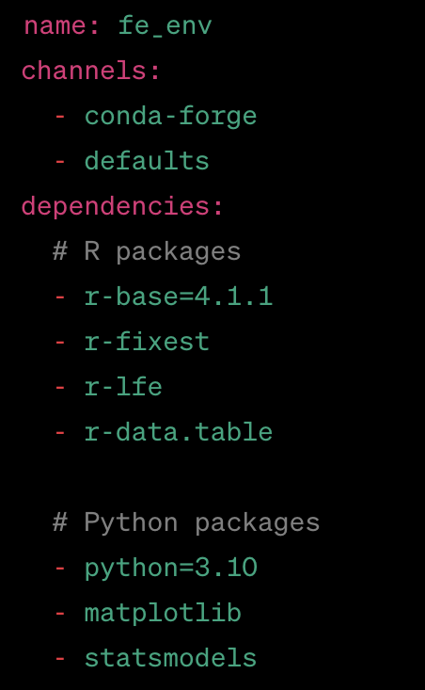
Creating a Fixed Effect Conda Environment
Using a text editor, create the following file on KLC called fe_env.yml
You can run this file using the mamba module on KLC to create the environment
module load mamba
mamba env create -f fe_env.yml
source activate fe_env
pip install FixedEffectModel

Slide 13
Activating a Conda Environment
To activate the environment in the future, either load mamba:
module load mamba
OR any version of conda:
module load python-anaconda3/2019.10
Then run this line to activate the environment:
source activate fe_env
To leave the environment:
source deactivate fe_env
To output the yaml file so you can share your environment with others:
conda env export > fe_env.yml

Slide 14
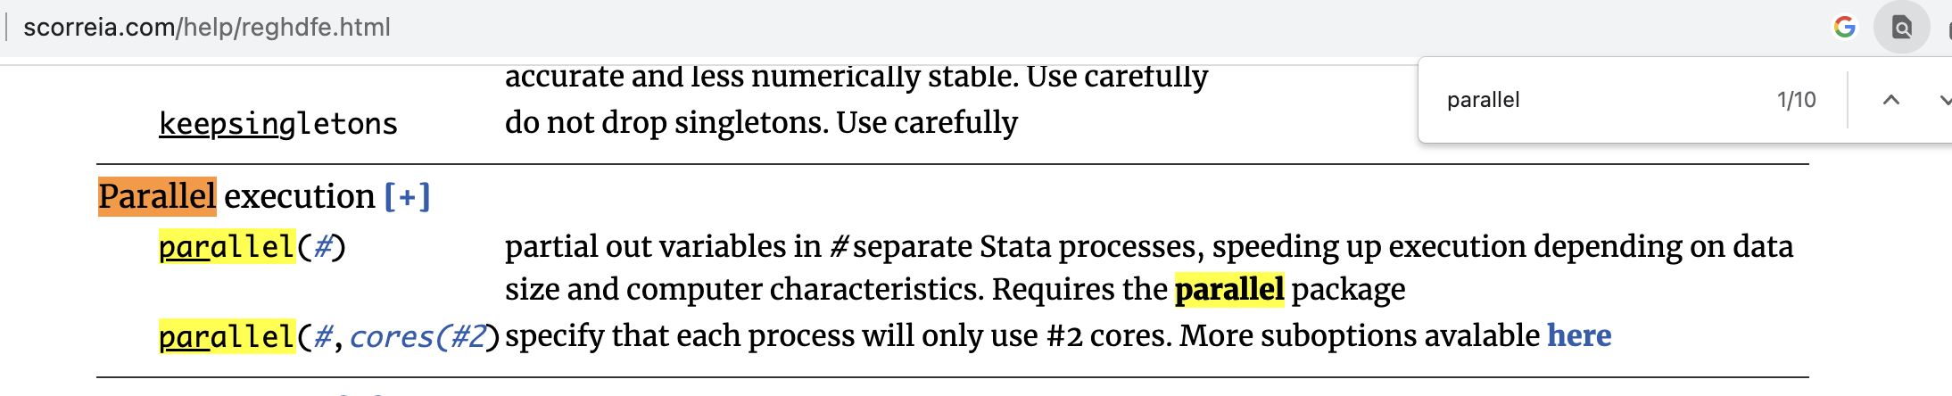
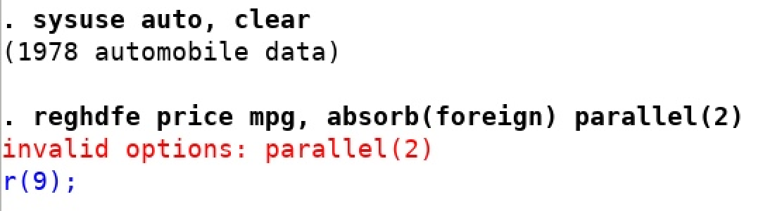
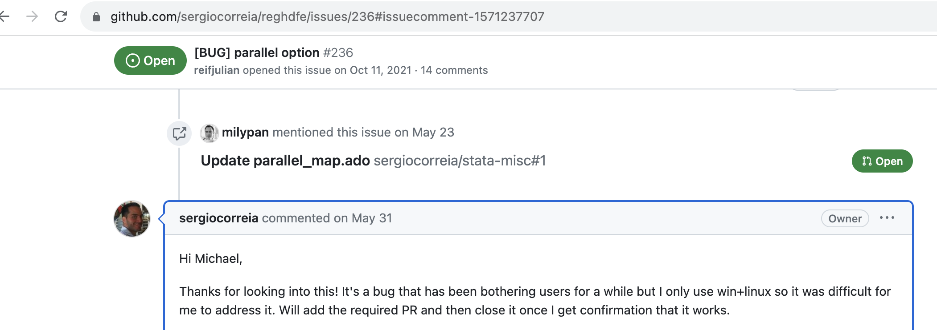
Version Control – A Cautionary Tale
To parallelize reghdfe the Stata documentation describes a “parallel” option:
However, this no longer runs in Stata 17:
Developer’s response:

Slide 15
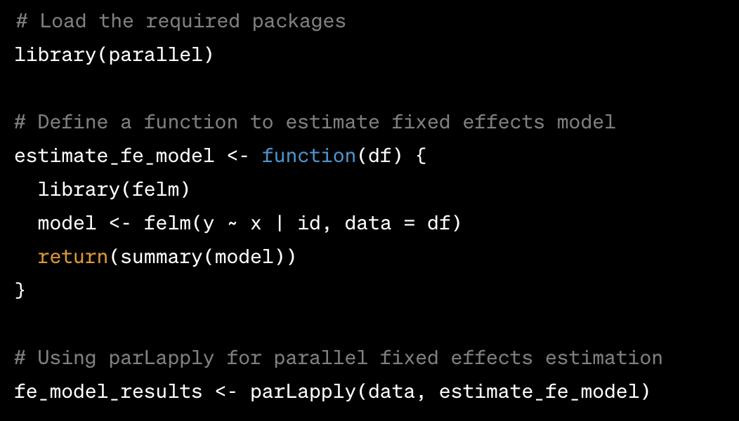
HD Fixed Effect Parallelization in R
Overview:
parallel library accelerates R computations by enabling simultaneous execution of tasks on multiple CPU cores.
Key Features:
parLapply: parallelizing tasks that require significant computation or when data needs to be shared across cores.
mclapply: Suited for scenarios with minimal data sharing and when independent tasks can be executed in parallel.

Slide 16
HD Fixed Effect Example Studies
Environmental Economics
Study: Impact of Green Regulations on Firm Emissions
Method: Fixed effects control for unobserved firm-specific characteristics and regulatory effects.
Labor Economics
Study: Gender Wage Gap Over Time
Method: Fixed effects capture gender-specific wage differentials by controlling for time-invariant factors.
Health Economics
Study: Effects of Universal Healthcare on Health Outcomes
Method: Fixed effects account for unobserved health-related characteristics and policy impacts.
Finance
Study: Determinants of Stock Returns Across Industries
Method: Fixed effects control for industry-specific factors influencing stock performance.

Slide 17
Takeaways:
Accounting for Rich Heterogeneity
Challenge: Complex interactions in multi-dimensional data.
Solution: High-dimensional fixed effects capture diverse unobserved factors.
Efficiently Handling Big Data
Challenge: Large datasets with numerous variables.
Solution: High-dimensional fixed effects manage high-dimensional control variables.
Uncovering Granular Insights
Challenge: Exploring nuanced effects in detailed contexts.
Solution: High-dimensional fixed effects reveal fine-grained patterns and relationships.

Slide 18
Proof

Slide 19
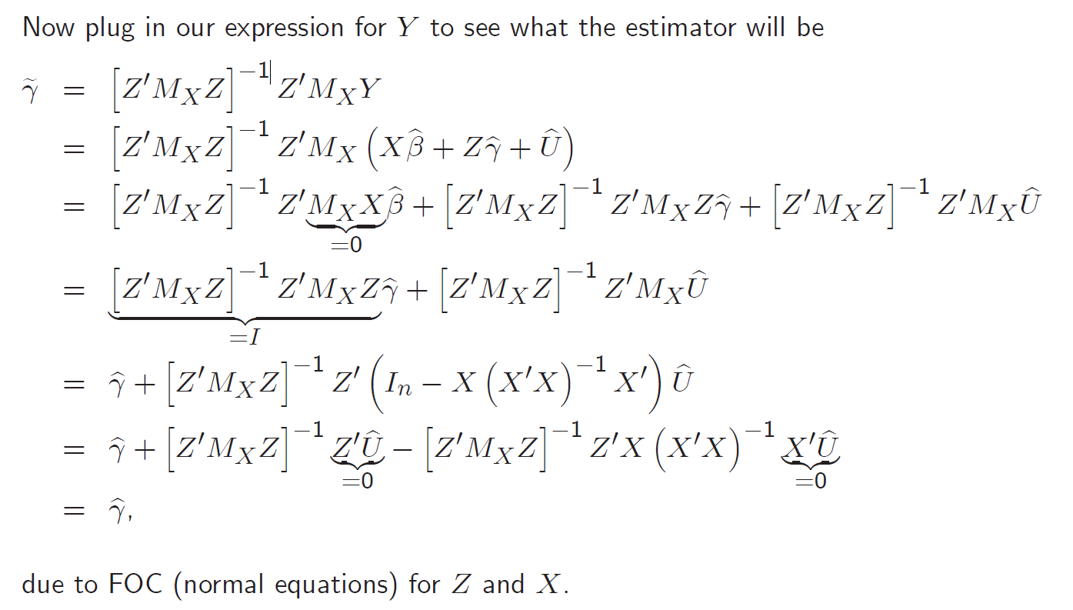
Proof – Cont’d

